Slide 1
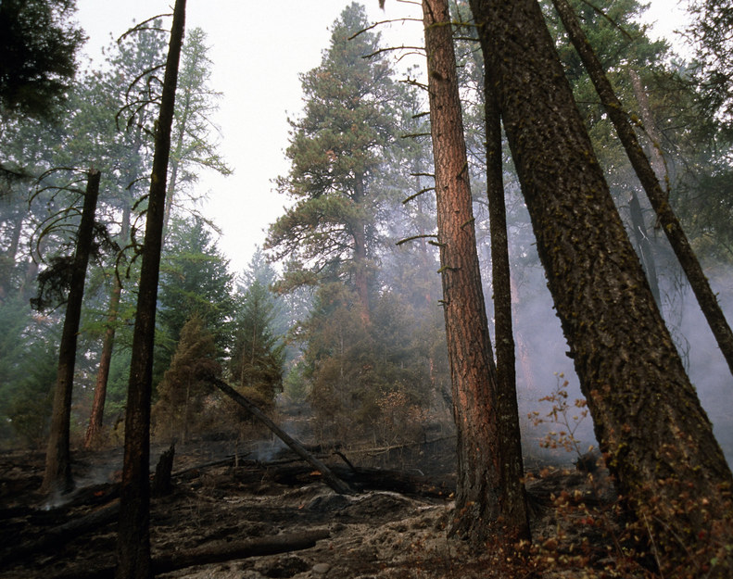
Effect of Prescribed Burning on Forest Microbial Community
Ri Desroches
Talyia Griffin
BIOMI6300
05/01/2024

Slide 2
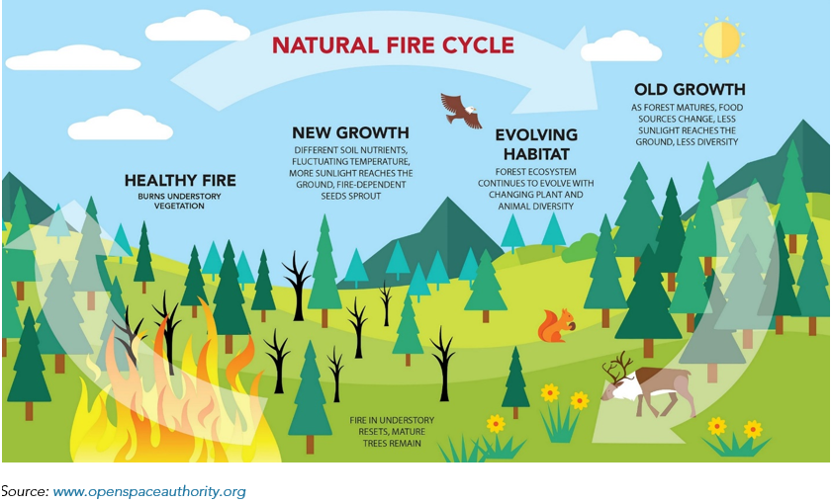
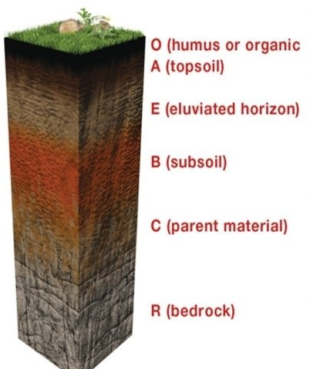
Background – Forest fires, prescribed burns, and soils
Notes:
Forest fire Image from here:
https://ww2.arb.ca.gov/resources/documents/frequently-asked-questions-wildfire-emissions
Soil image from here:
https://tunza.eco-generation.org/worldReportView.jsp?viewID=52477

Slide 3
Scientific question and hypothesis
How do forest fires impact soil microbial communities in different soil horizons?
Hypothesis:
Prescribed burns would cause significant community shifts
DIC vs DOC
Changes in pH
Extremophiles appear

Slide 4
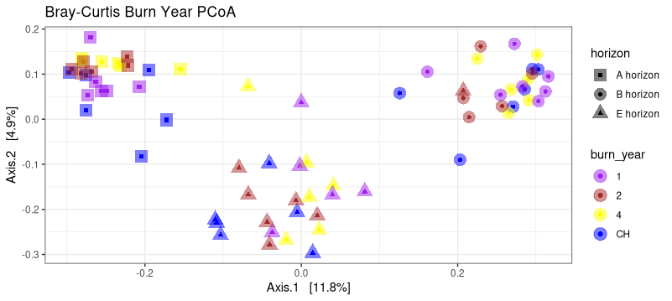
Variance in data is attributed soil horizon of samples as opposed to the burn timeframe

Slide 5
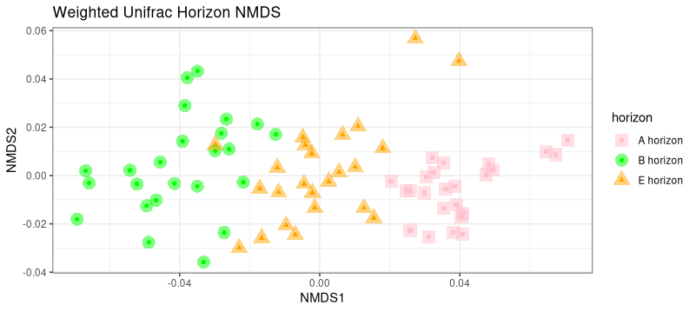
NMDS analysis results in low-stress model using soil horizon

Slide 6
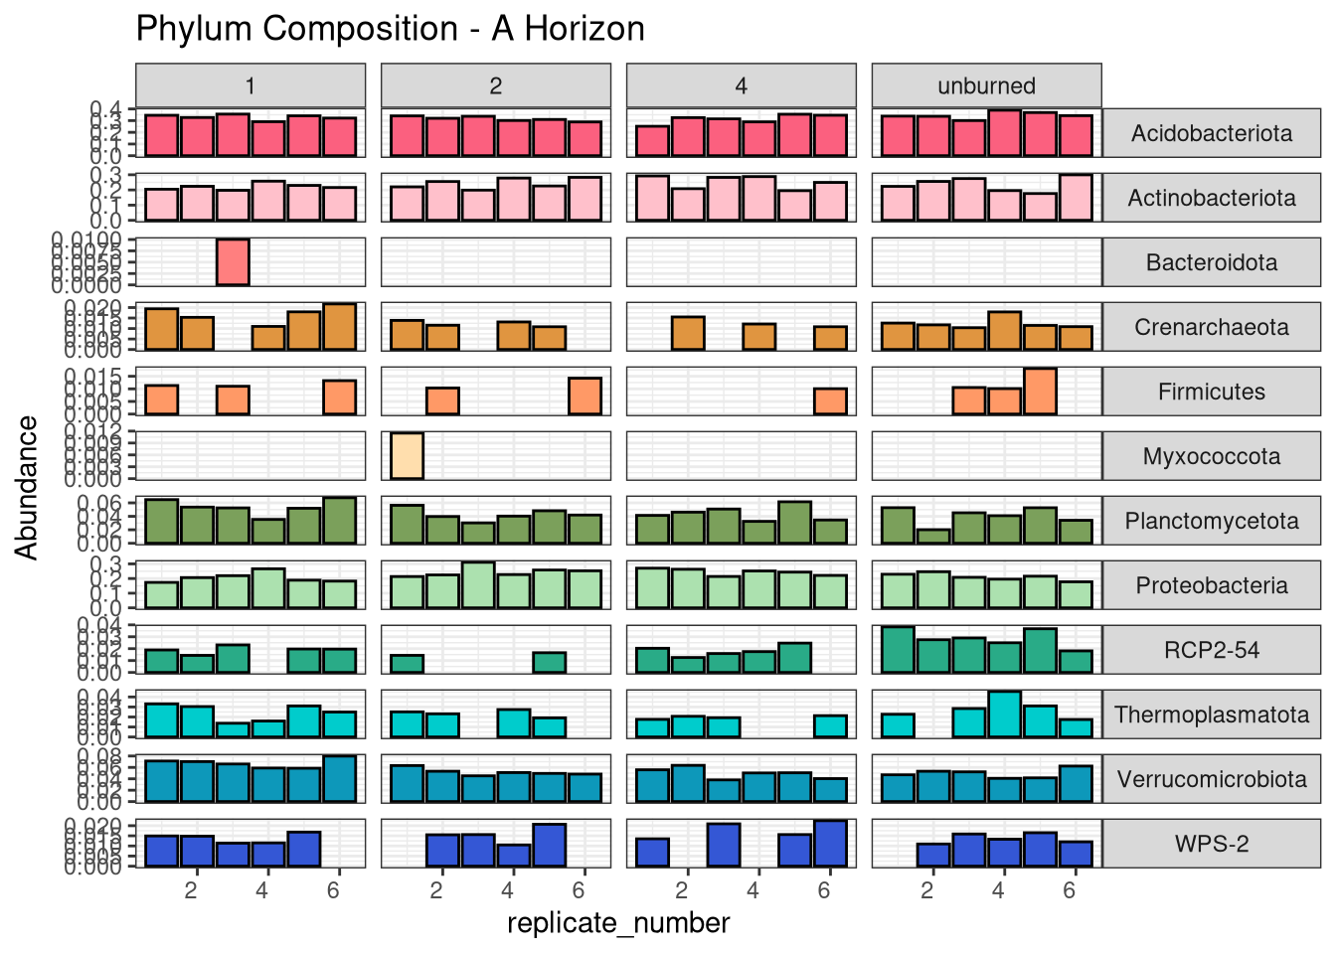
Relative abundance at the Phylum level remains consistent across all burn time frames in each soil horizon
Notes:
Note : nitrospirota and chloroflexi appearance at lower soil horizons
Disappearance of WPS-2

Slide 7
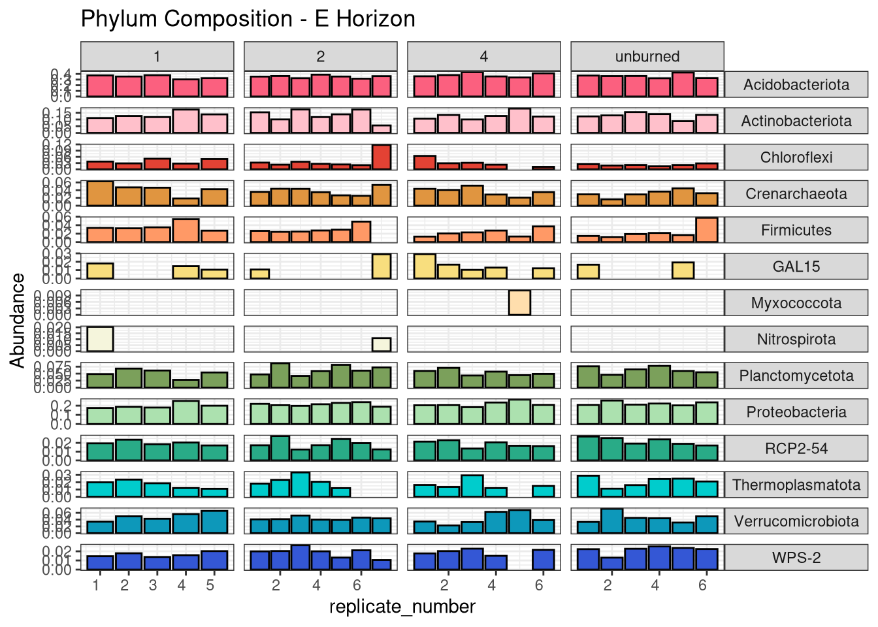
Relative abundance at the Phylum level remains consistent across all burn time frames in each soil horizon

Slide 8
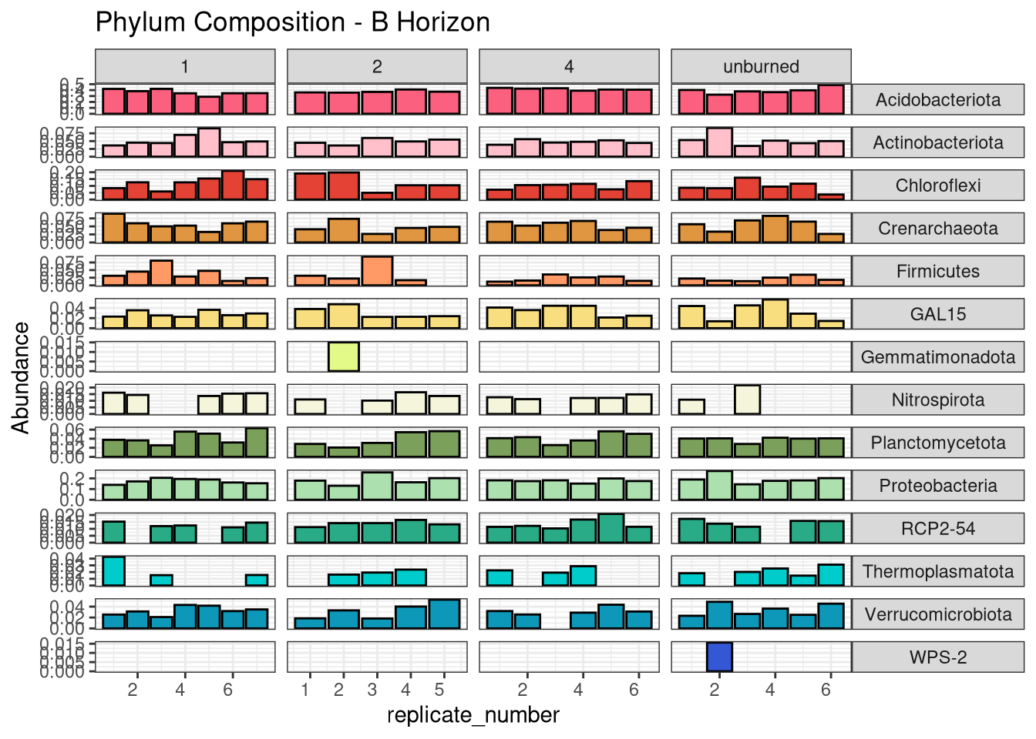
Relative abundance at the Phylum level remains consistent across all burn time frames in each soil horizon

Slide 9
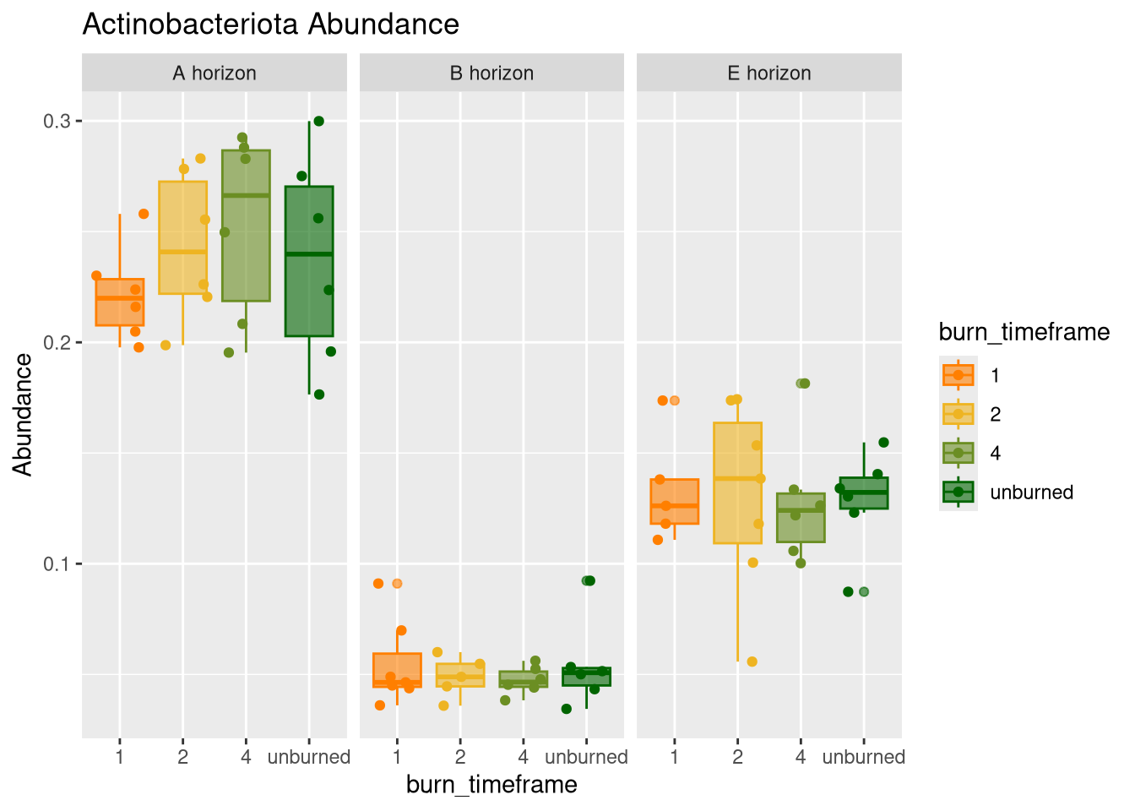
Actinobacteriota abundance varies significantly across soil horizons, and slightly across burn timeframes in a soil horizon

Slide 10
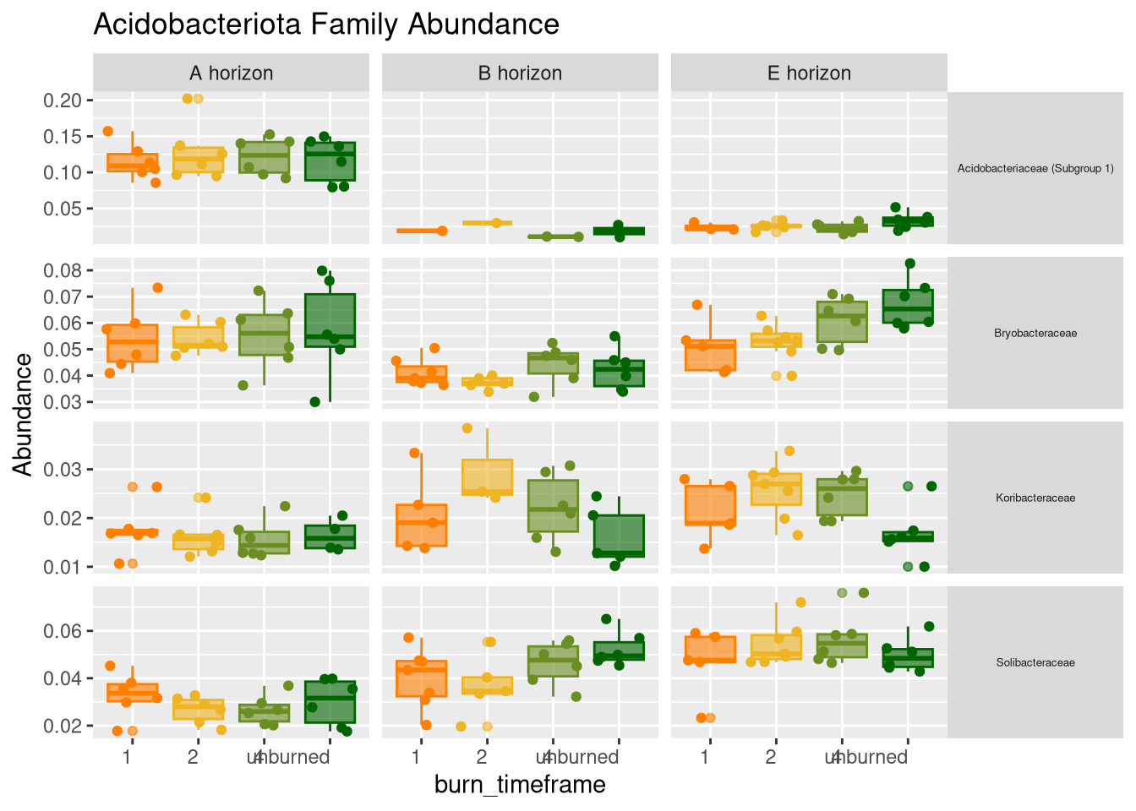
Soil horizon, rather than prescribed burn timeframes, affect abundances of most Family taxonomic groups within the Acidobacteriota phylum

Slide 11
Conclusions
Samples cluster strongly and significantly based on their soil horizon, and less so based on their burn timeframe
Within a soil horizon group, there is no significant separation or clustering based on the burn timeframe
Prescribed burns do not significantly disrupt soil community composition

Slide 12
Data citation
Fox, Sam and Taylor, Melanie K. and Jumpponen, Ari, Fire-Excluded and Frequently Burned Longleaf Pine Forests Have Contrasting Soil Microbial Communities. Available at SSRN: https://ssrn.com/abstract=4415149 or http://dx.doi.org/10.2139/ssrn.4415149

Slide 13
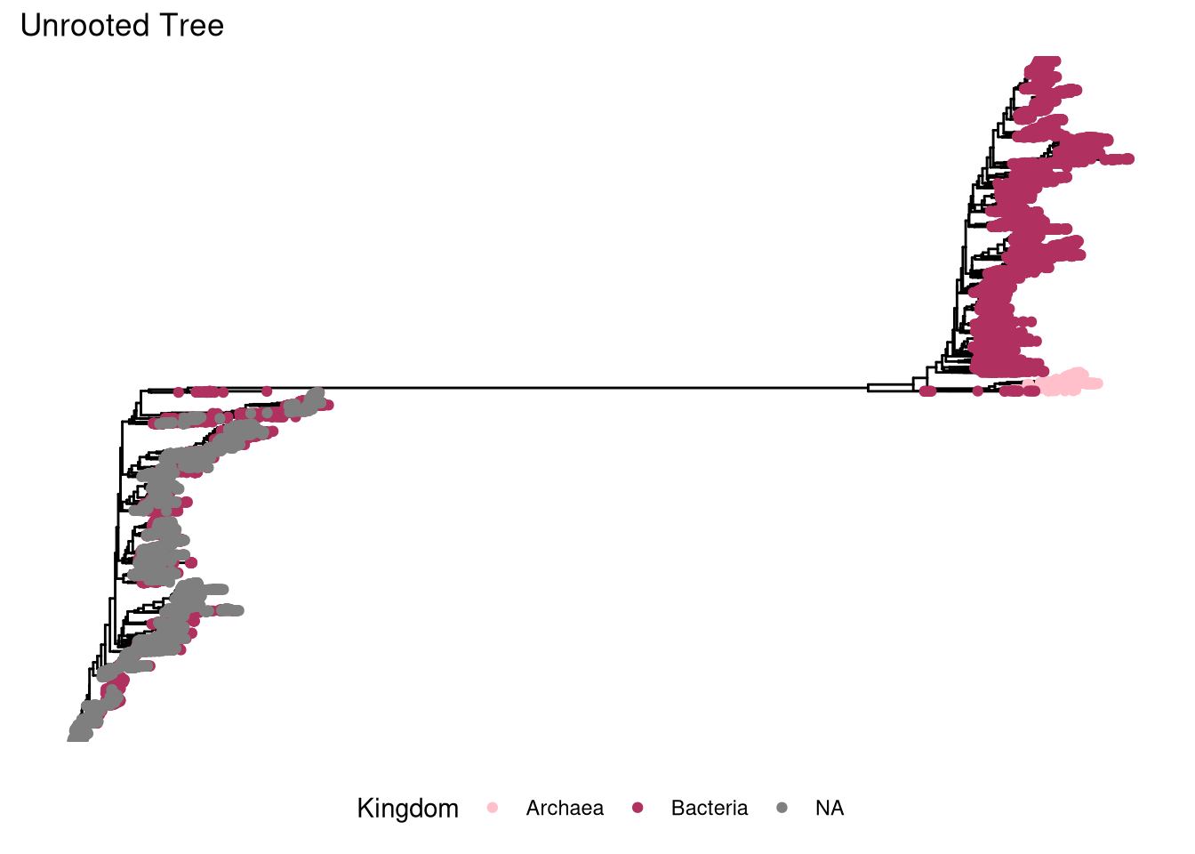

Unrooted tree of ASVs shows a high number of unclassified taxa at the Kingdom level, and a large split in the tree

Slide 14
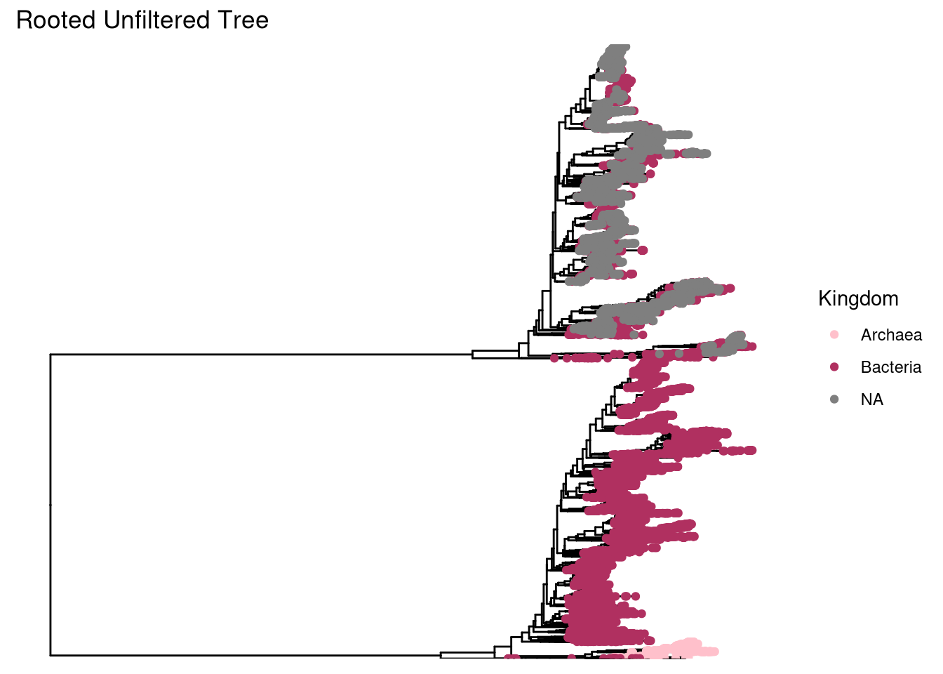
Rooting the tree still results in a major split into two very distinct groups: Bacterial- and Archaeal-classified ASVs, and a mix of Bacterial and unclassified ASVs

Slide 15
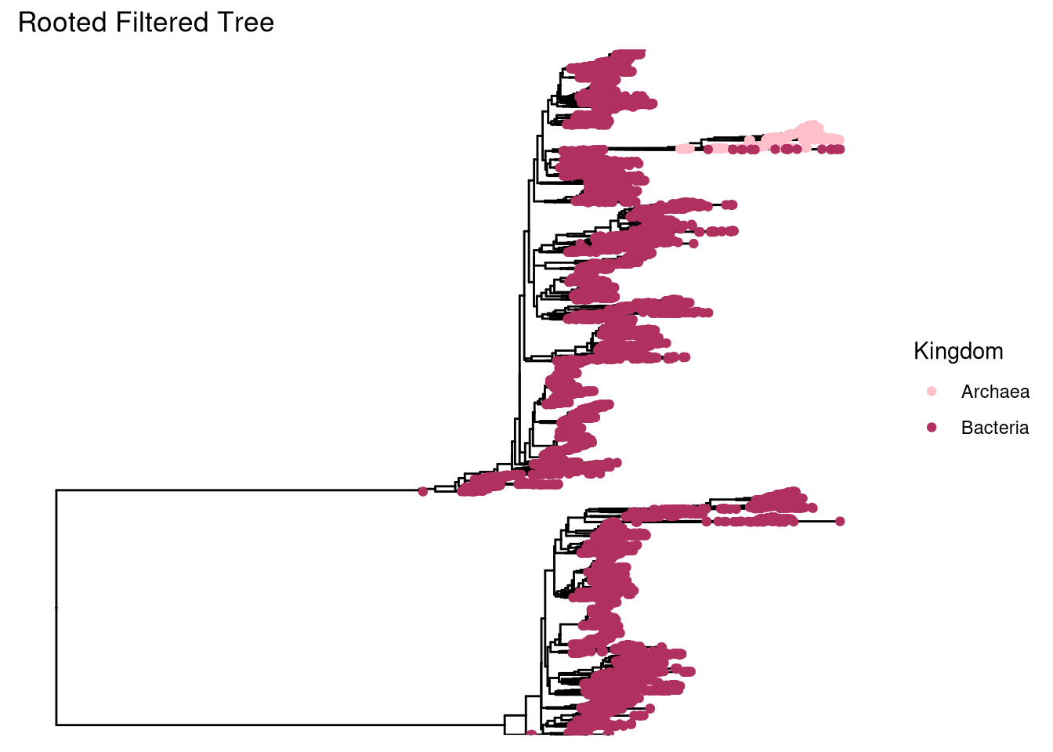

The phylogenetic tree maintains a very dramatic split into two major groups, even after filtering out the ASVs that are unclassified at the kingdom level and rerooting the tree

